Slide 1

Introduction to OpenShift
Amit Kumar
Blog :- amitvashist.wordpress.com

Slide 2
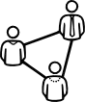


Digital Transformation
Requires an Evolution in...
APPLICATIONS
New ways of developing, delivering and integrating applications
PROCESS
More agile processes across both IT and the business
INFRASTRUCTURE
Modernize existing and build new cloud based infrastructure
2

Slide 3
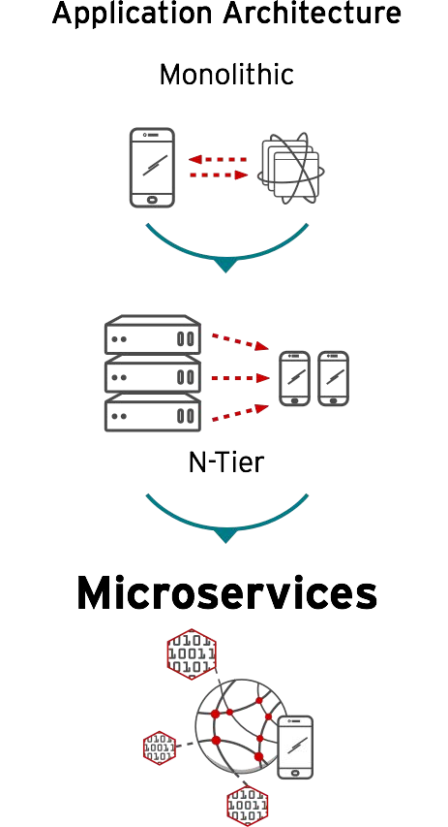
Application Architecture
Shift from monolithic applications to microservices
Independently deployable and updatable, limited dependencies
Optimized for agility & accelerated time to market
3

Slide 4
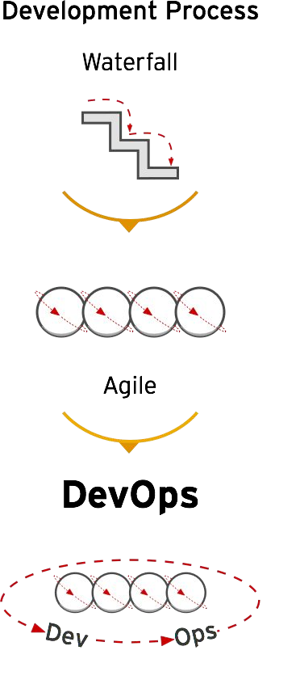
Development Process
Shift to more agile development and deployment processes
Increased collaboration between Development & Operations
Move from Continuous Integration to Continuous Deployment

Slide 5
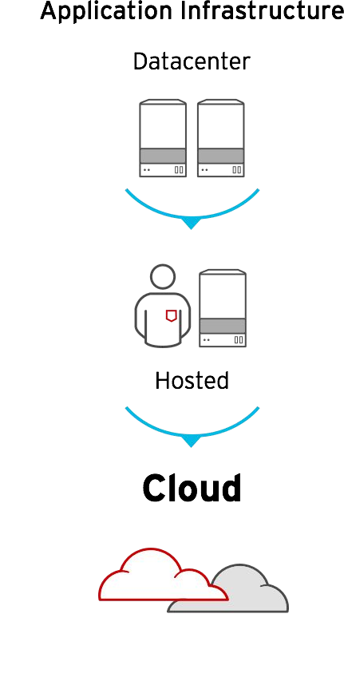
Platform Infrastructure
Shift from virtualization to scale-out cloud infrastructure
Rapid growth in public cloud usage for enterprises
Hybrid cloud deployments span private & multiple public clouds

Slide 6
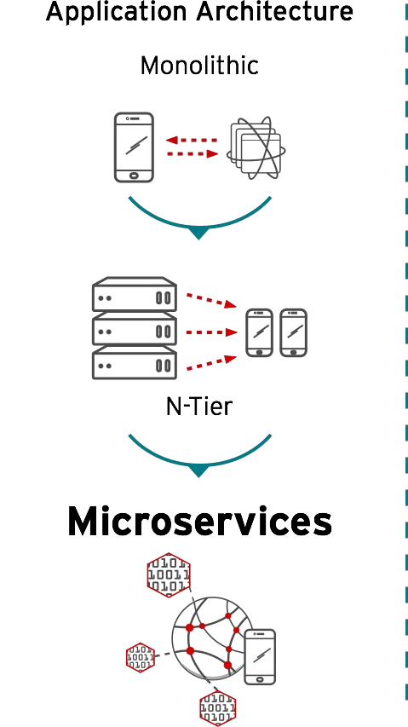
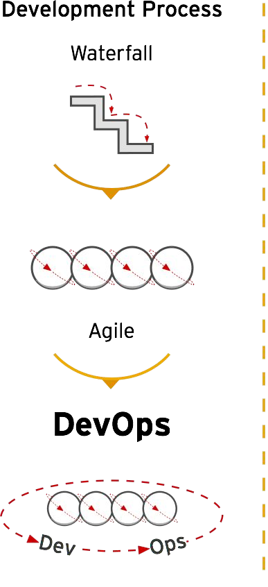
IT Must Evolve to Stay Ahead of These Trends

Slide 7
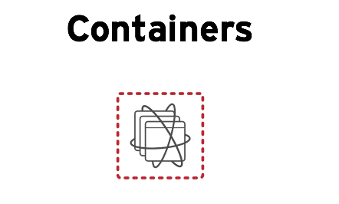
Containers - Transform Apps, Infrastructure & Process

Slide 8
What Are Containers?
It Depends on Who You Ask
INFRASTRUCTURE
APPLICATIONS
Sandboxed application processes on a shared Linux OS kernel
Simpler, lighter, and denser than virtual machines
Portable across different environments
Package my application and all of its dependencies
Deploy to any environment in seconds and enable CI/CD
Easily access and share containerized components

Slide 9
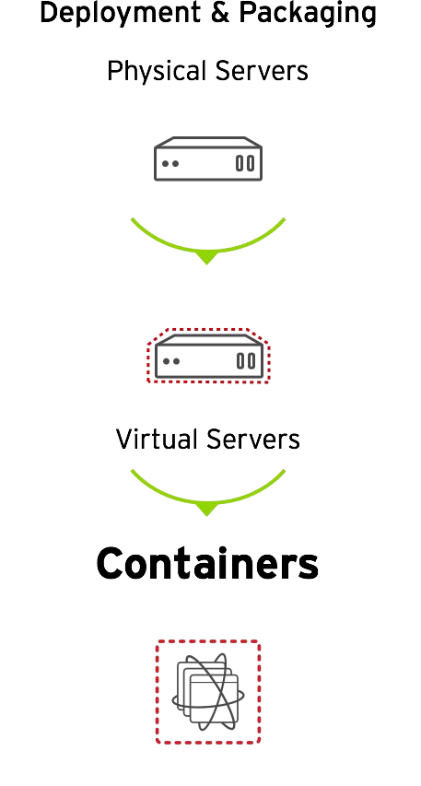
Containers - An Evolution in Application Deployment
Enable efficiency and automation for microservices, but also support traditional applications
Enable faster and more consistent deployments from Development to Production
Enable application portability across 4 infrastructure footprints: Physical, Virtual, Private & Public Cloud

Slide 10


Red Hat Container Stack & Tools
Traditional, Stateful & Microservices-based Apps
Red Hat Registry
Red Hat Application Services (JBOSS)
Business Automation | Integration | Data | Web & Mobile | 3rd party frameworks
CONTAINER | CONTAINER | CONTAINER | CONTAINER | CONTAINER
PaaS
CloudForms
Red Hat OpenShift Container Platform (incl. CloudForms)
LIFECYCLE AUTOMATION
(Self-service, CI/CD, Image Stream)
CONTAINER MANAGEMENT
(Monitoring, Capacity, Policies)
Ansible
CaaS
Storage
CONTAINER INFRASTRUCTURE
(Orchestration & Scheduling, Storage, Registry, Security, Networking)
Satellite
Red Hat Enterprise Linux & Atomic Host
ENTERPRISE-GRADE CONTAINER OS
Developer Studio
IaaS
CDK

Slide 11
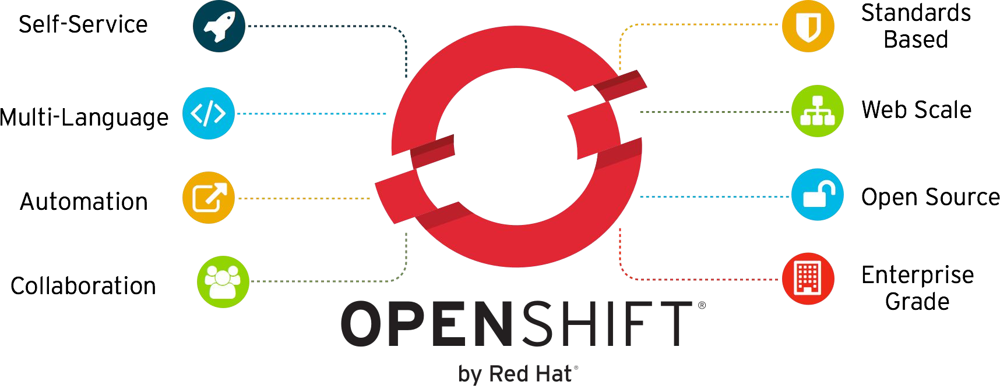
OpenShift Enables Dev and Ops

Slide 12
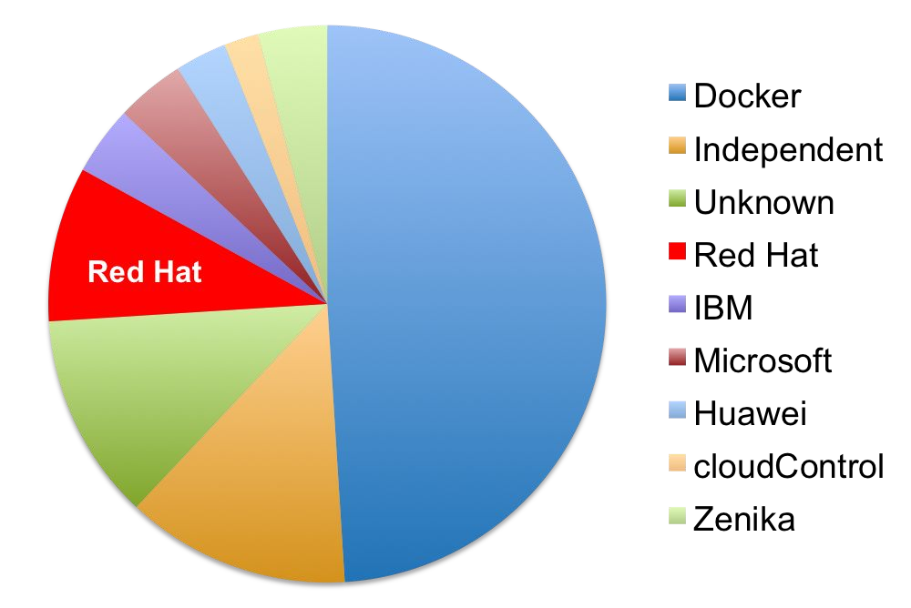
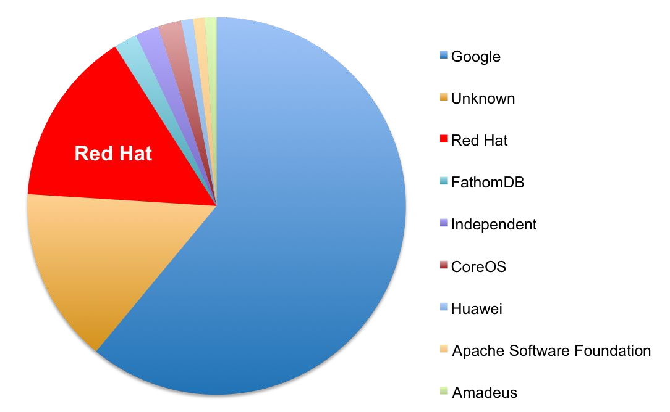
Built on Open Container Standards
Red Hat Driving These in the Community
docker
kubernetes

Slide 13
Trusted Container OS
Containers Depend on Linux
CONTAINER
CONTAINER
CONTAINER
CONTAINER
CONTAINER
RED HAT ENTERPRISE LINUX
CONTAINER RUNTIME & PACKAGING (DOCKER)
ATOMIC HOST

Slide 14


Container Runtime - Standards & Security
Docker release updates & maintenance
Standardization through OCI
Multi-process containers with systemd
CONTAINER
APP
RUNTIME
OS
New in RHEL 7.3:
Image scanning with Atomic Scan + OpenScap.
Container image signing
System Containers
HOST OS

Slide 15
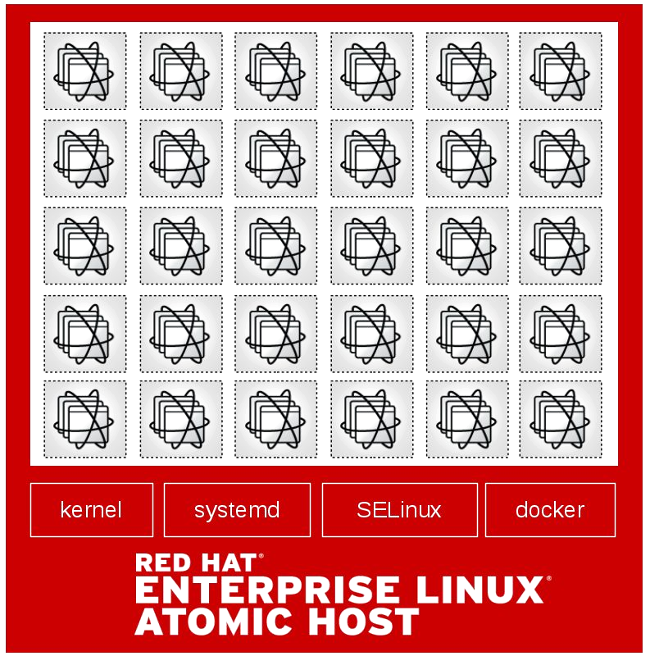
Container Host - Lightweight & Container-Optimized
RHEL Atomic Host - optimized for containers, minimal footprint & streamlined updates.
Enhanced management with Cockpit for RHEL & RHEL Atomic Host
SELinux support with OverlayFS (7.3.2)
Package layering (Tech Preview)
Containerized install of Kubernetes
RHEL base image size optimization

Slide 16
Clustered Container Infrastructure
Applications Run Across Multiple Containers & Hosts
CONTAINER
CONTAINER
CONTAINER
CONTAINER
CONTAINER
CONTAINER ORCHESTRATION & CLUSTER MANAGEMENT (KUBERNETES)
NETWORKING
STORAGE
REGISTRY
LOGS & METRICS
SECURITY
RED HAT ENTERPRISE LINUX
CONTAINER RUNTIME & PACKAGING (DOCKER)
ATOMIC HOST

Slide 18
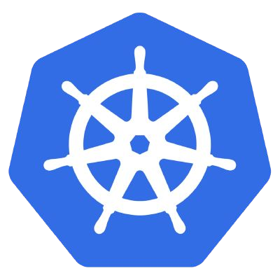
Container Orchestration - Scale & New Workloads
Kubernetes 1.3 (OpenShift 3.3)
Scale to 1,000+ Node clusters
Workload eviction from Nodes
Routing control for A/B deployments
Kubernetes 1.4 & 1.5
Federated clusters with Ubernetes
Expanded workload support with PetSets and related enhancements

Slide 19





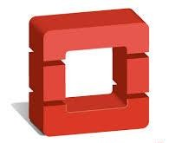
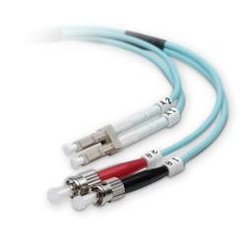
Storage Plugins for Stateful Services
iSCSI
NFS
Amazon EBS
Google Persistent Disk
GlusterFS
Ceph RBD
OpenStack Cinder
Fibre Channel
pDisk
EBS
iSCSI
NFS
Cinder
Fiber Channel

Slide 20
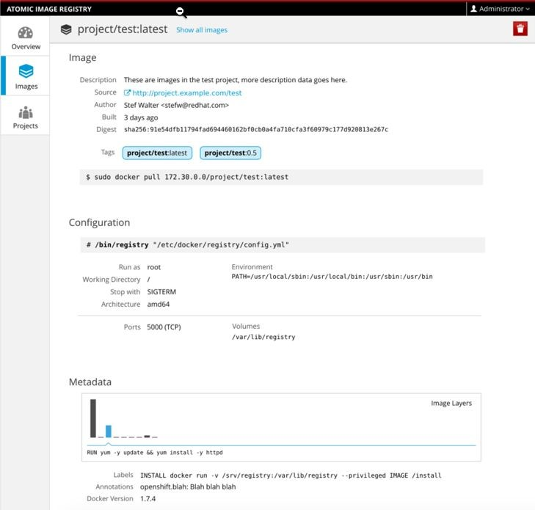
Enterprise Registry
Manage image content with new integrated registry capabilities
Registry access and image management
Visualization of image metadata and image layer details
Standalone registry install option

Slide 21

Enterprise Container Platform
Build, Deploy and Manage Containerized Apps
CONTAINER | CONTAINER | CONTAINER | CONTAINER | CONTAINER
SELF-SERVICE
SERVICE CATALOG (LANGUAGE RUNTIMES, MIDDLEWARE, DATABASES, …)
BUILD AUTOMATION |  |  |  | DEPLOYMENT AUTOMATION
APPLICATION LIFECYCLE MANAGEMENT (CI / CD)
CONTAINER ORCHESTRATION & CLUSTER MANAGEMENT (KUBERNETES)
NETWORKING |  | STORAGE | REGISTRY |  | LOGS & METRICS | SECURITY
INFRASTRUCTURE AUTOMATION & COCKPIT
 | CONTAINER RUNTIME & PACKAGING (DOCKER)
 | ATOMIC HOST
RED HAT ENTERPRISE LINUX

Slide 22
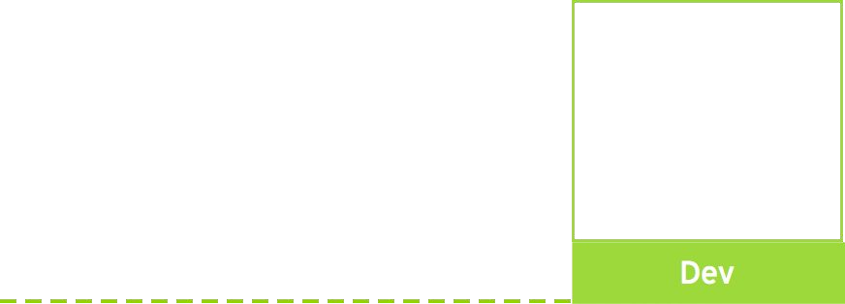

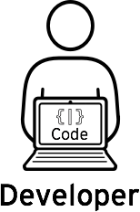



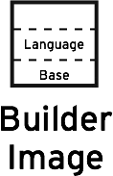
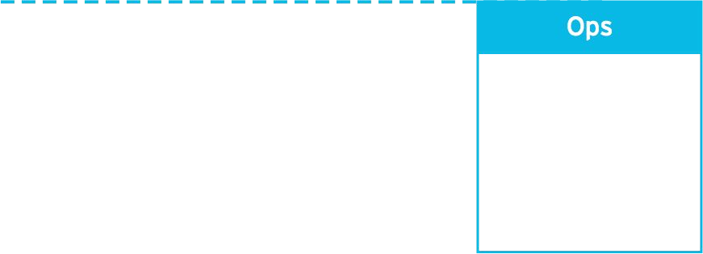
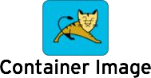
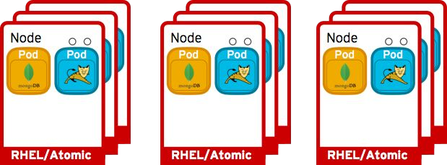
Build & Deployment Automation
Can configure triggers for automated deployments, builds, and more.
Code
Build
Can configure different deployment strategies like A/B, Rolling upgrade, Automated base updates, and more.
Deploy

Slide 23
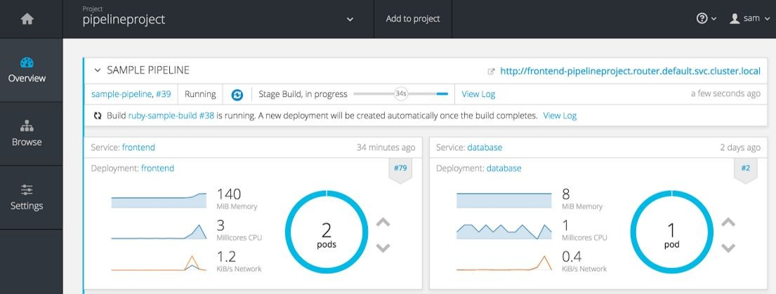
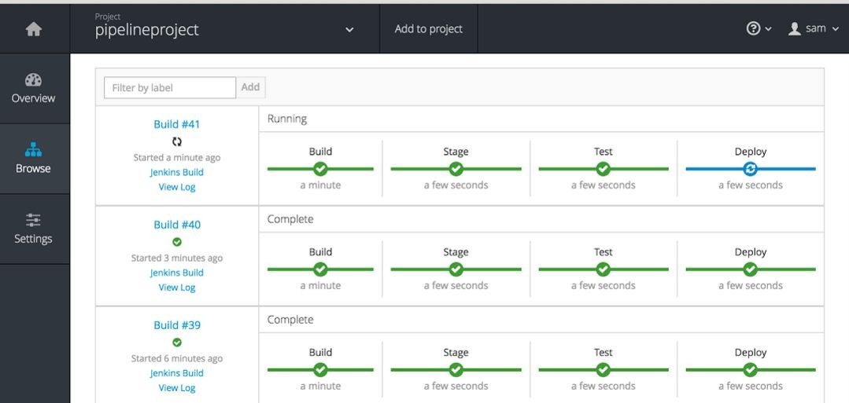
Continuous Deployment Pipelines
Define and manage the whole application lifecycle
Build/Deploy workflows from Dev to Production
Integrated Jenkins 2 Pipeline extensibility
Real time status and integrated metrics

Slide 24

JBoss Middleware Services on OpenShift
Java EE Application Server
By JBoss EAP
Integration Services
By JBoss Fuse
Real time Decision Service
By JBoss BRMS
In Memory Data Grid
By JBoss Data Grid
Messaging Services
By JBoss A-MQ
Intelligent Process Server
By JBoss BPM Suite
Tomcat
By JBoss Web Server
Single Sign On
By RH SSO
API Management
Data Services By JBoss Data Virtualization

Slide 25
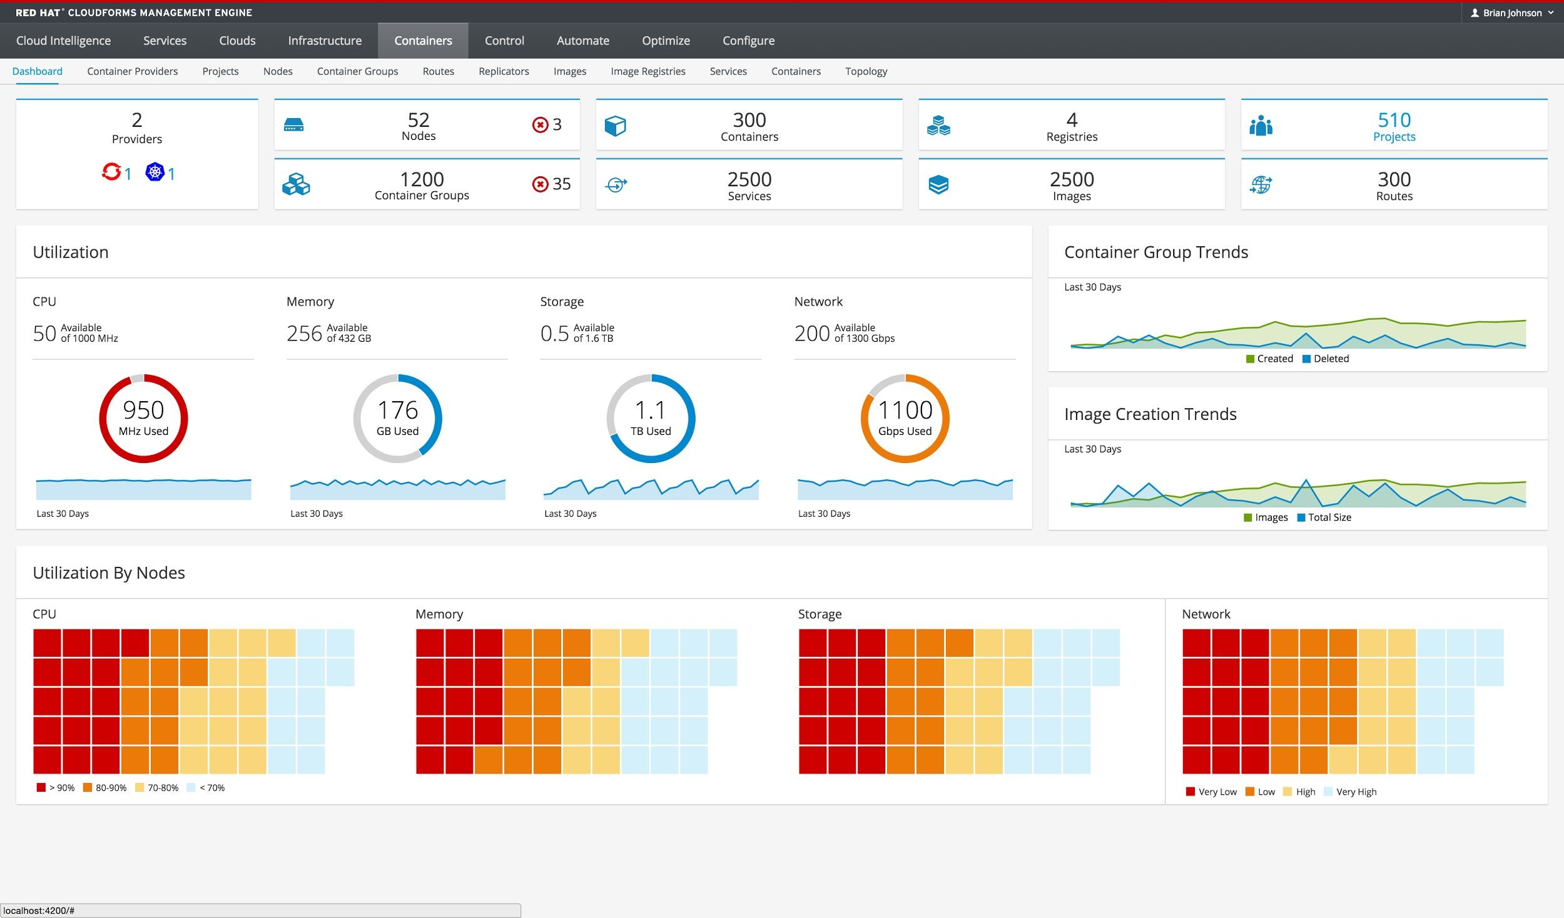
CloudForms Container Management
Manage containers and OpenShift across a hybrid cloud environment
Reports, metrics & alerts
Container chargeback
Vulnerability Scanning

Slide 26

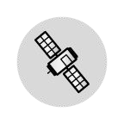
Managing Containers Today
Support - OpenShift and Atomic Host as container providers
Dedicated dashboard - Topology mapping for containers, nodes, pods and registries
Configuration management - Drift analysis of container image packages
Performance monitoring - CPU & memory utilization
4.0
RED HAT
CLOUDFORMS
Introspection - Agent-less container content analysis for security and compliance assessment
Policy automation - Kubernetes events in policy definition
Performance monitoring - Networking & storage utilization
Chargeback
4.1
6.1
Container Deployment - Integrate container deployment in lifecycle workflow
RED HAT SATELLITE
Lifecycle management - Atomic Host: provision, patch and update, retire
6.2

Slide 27
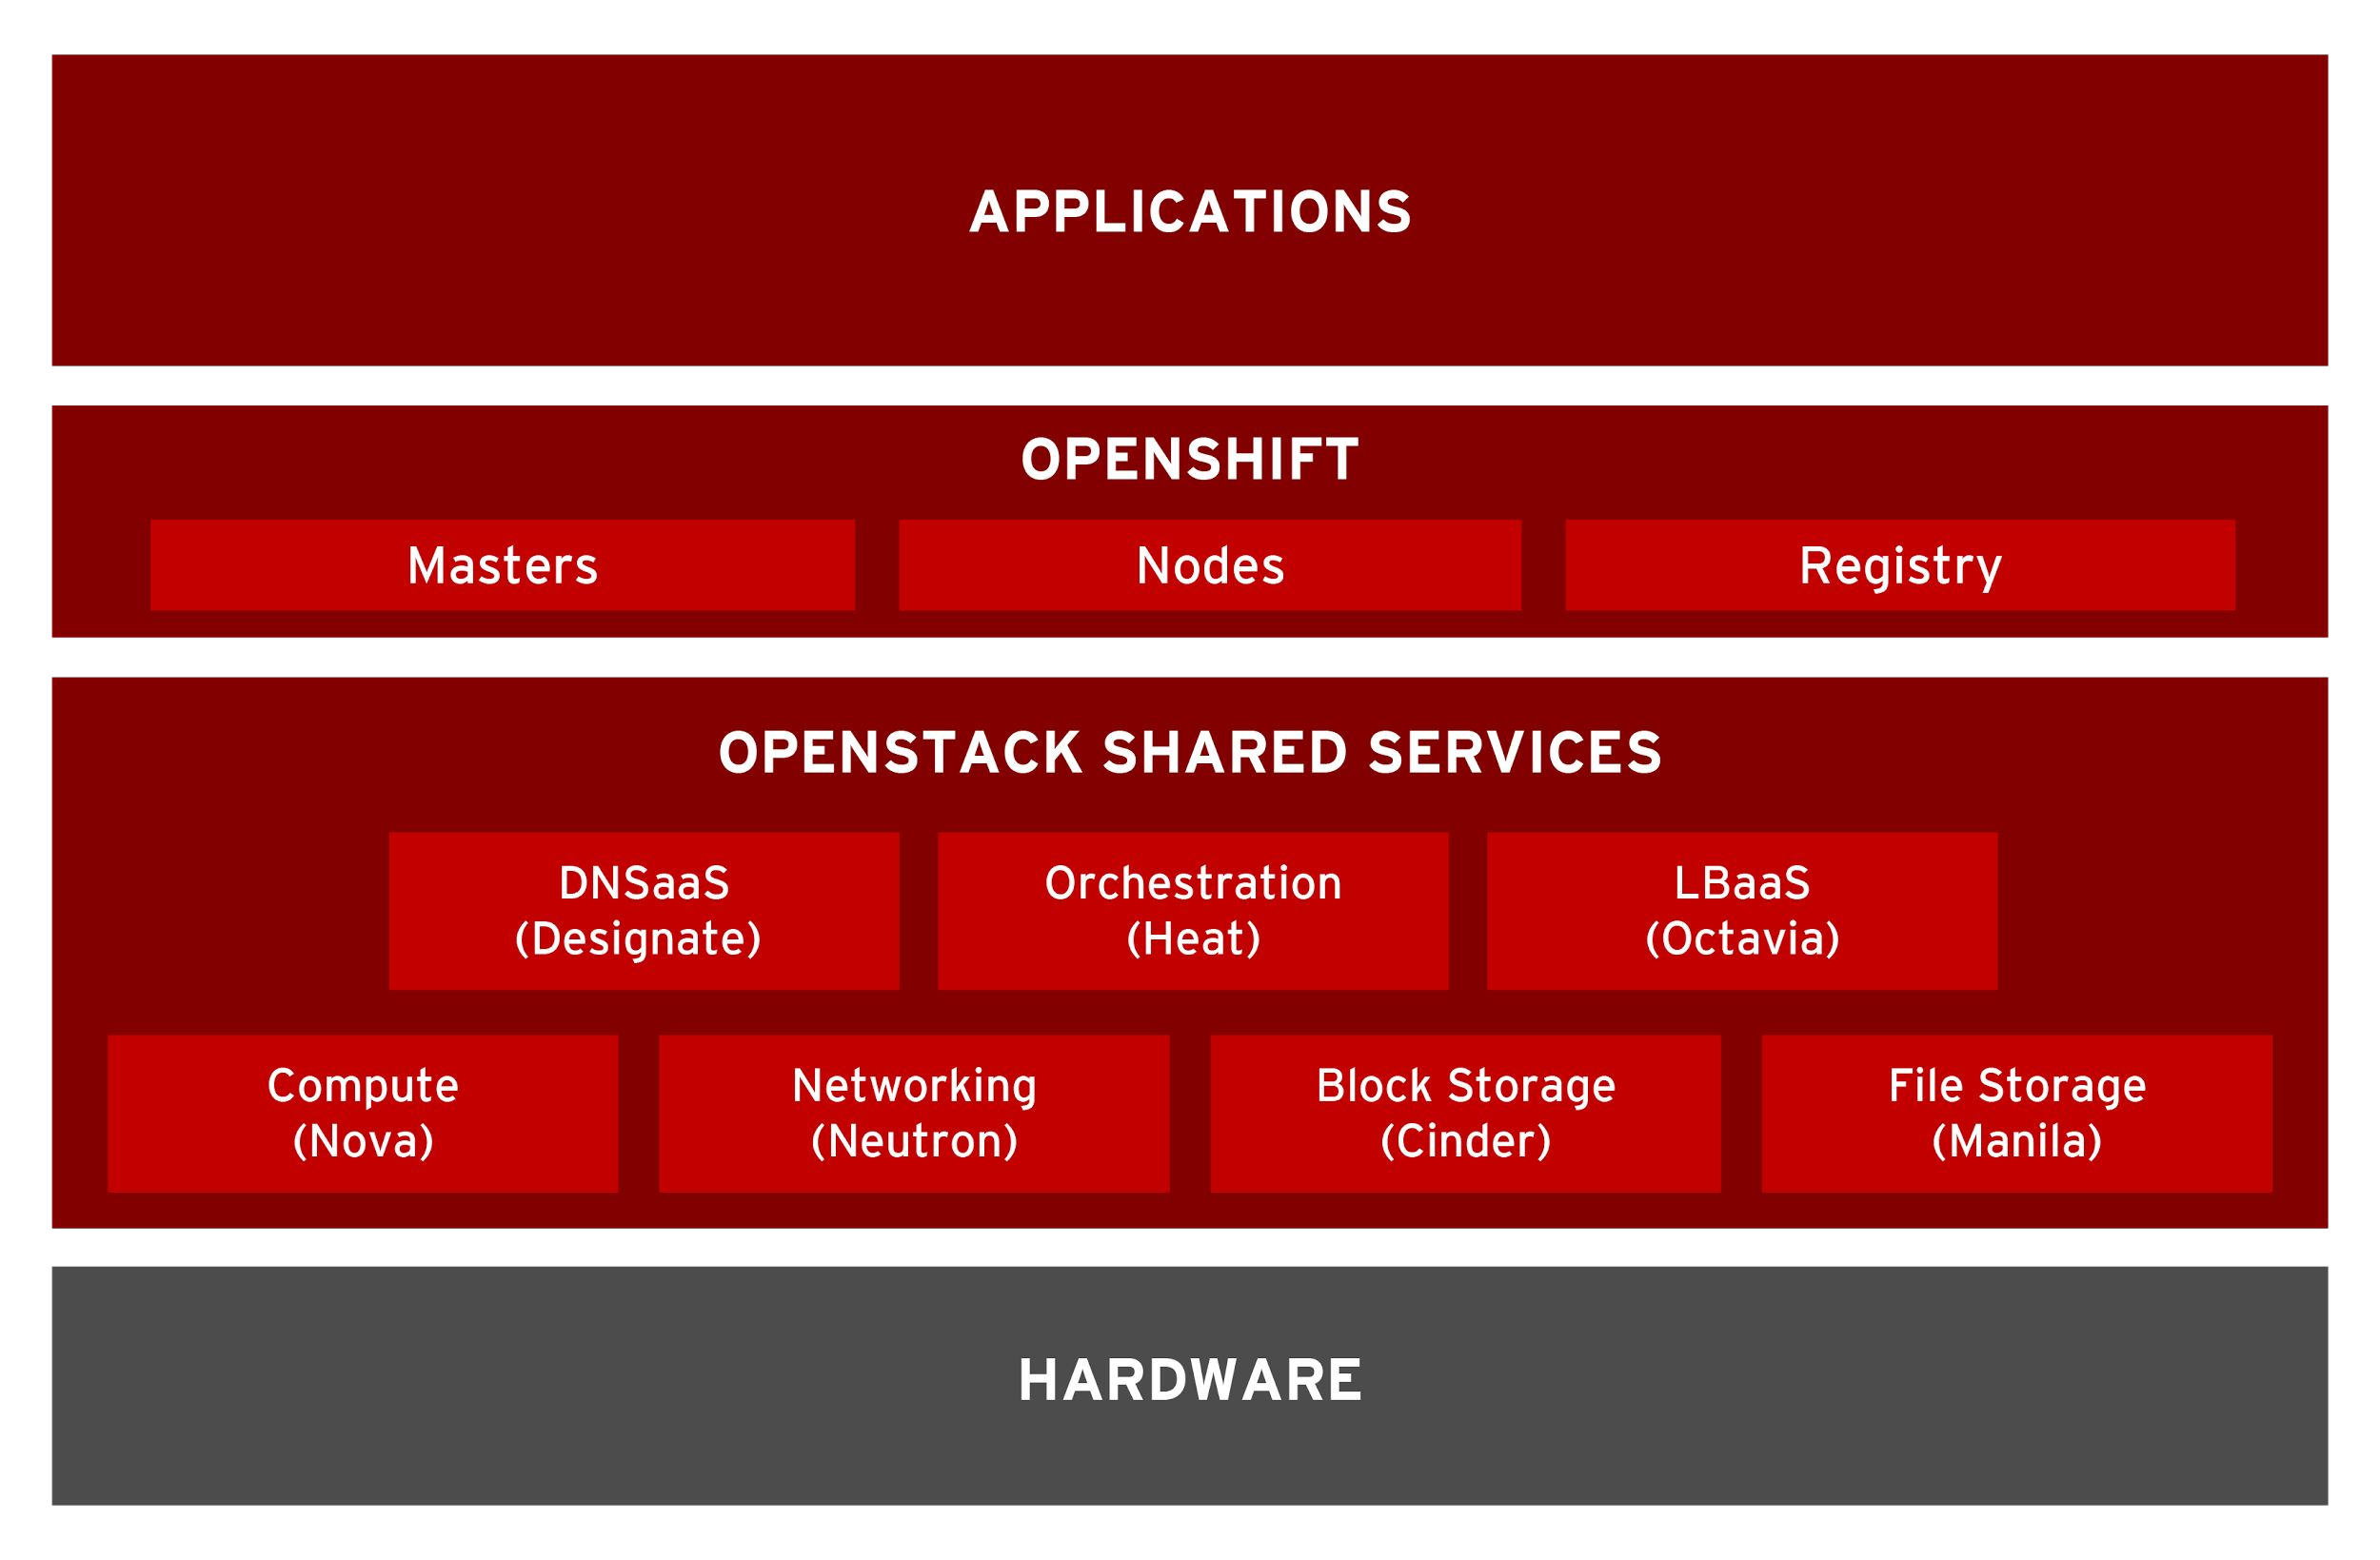
OpenShift on OpenStack - Current
Networking via Neutron
networks.
Load Balancing via Neutron
LBaaS V1
Block Storage via Cinder
volumes.
Compute via Nova virtual machines.
Orchestration via Heat
templates.
Reference architecture to be published “real soon now”

Slide 28
OpenShift on OpenStack - Future
Load Balancing via
Octavia (LBaaS V2)
DNS via Designate
File Storage via Manila
Re-validate architecture on bare-metal using Ironic

Slide 29
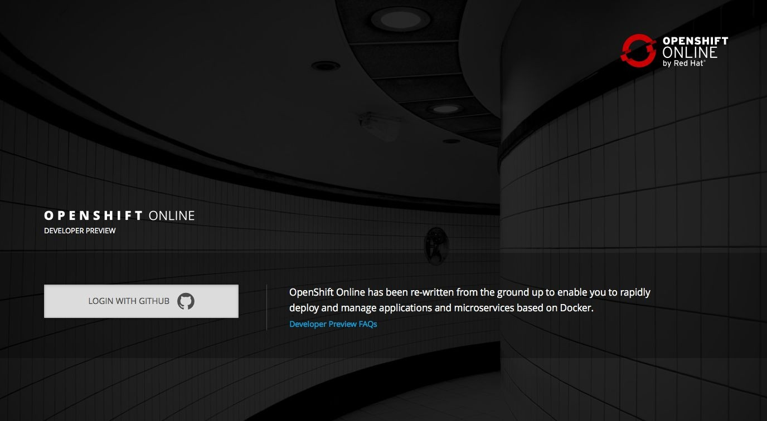
OpenShift Online - “The Next Generation”
Public cloud-based, multitenant container platform
Automatically build and deploy container workloads in the cloud
Superior developer experience
Built-in operations management
OpenShift Online DevPreview available

Slide 30
OpenShift - Use Case Based Segmentation
ON-PREMISE
[NEW] Red Hat OpenShift Container Local
PUBLIC CLOUD
[NEXT-GEN] Red Hat OpenShift Online
ADOPT
[NEW] Red Hat OpenShift Container Lab*
Red Hat OpenShift Dedicated
EXPAND
[NEW NAME] Red Hat OpenShift Container Platform*
Red Hat OpenShift Dedicated
COMMIT
Red Hat Cloud Suite
TRANSFORM
* Also available as RHEL Add-On [NEW]

Slide 31

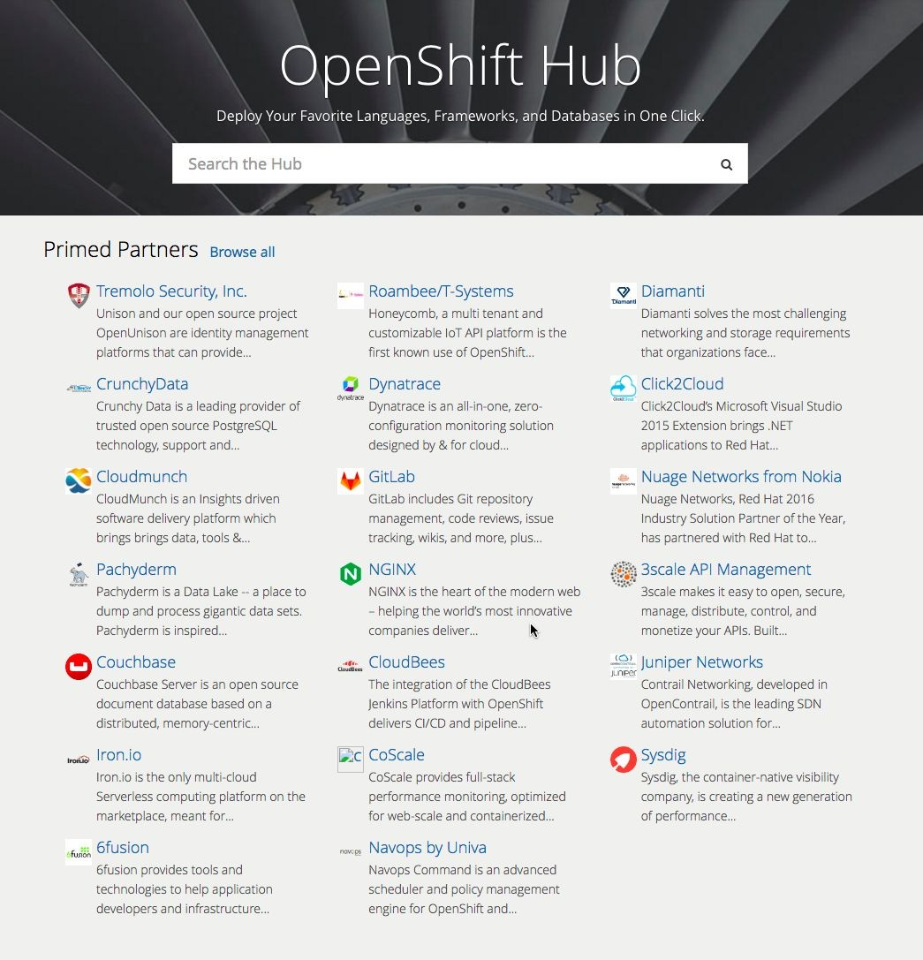
OpenShift Primed
What is it?
Technical readiness program for OpenShift ISV partners
Applies to any variant of OpenShift including upstream
Designated logo and awareness through OpenShift online properties
First step in journey towards Red Hat corporate level certification
20+ “Primed” Partners since program launched at Red Hat Summit 2016

Slide 32
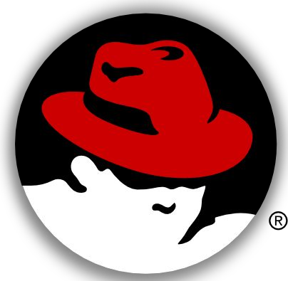
Host Level Security
Namespaces
Mount, PID, IPC, UTS, Network, User
Cgroups
Constraints, but also restrict access to device nodes
Capabilities
38 distinct sets
Selinux
Type Enforcement
Multi Category Security
Seccomp
Disabling SYS_CALLS
Rlimits
RLIMIT_NOFILE, RLIMIT_NPROC

Slide 33

Platform Level Security
Container Level Separation
Docker layer ownership via S2I
OpenShift API Authentication
X509 CERT, OAuth Access Token, SAML
OpenShift Identity Integrations
Roles, LDAP, AD
OpenShift Service Accounts
Platform driven actions
OpenShift Security Contexts
Pod Security Policies
OpenShift Secrets
Encrypted variable values
OpenShift Image Builds
Control Priv, dockerfile, build strategies

Slide 34
THANK YOU
plus.google.com/+RedHat
facebook.com/redhatinc
linkedin.com/company/red-hat
twitter.com/RedHatNews
youtube.com/user/RedHatVideos

